Slide 1
Digital System Design CE 325 L1 SPRING 2024
Instructor : Dr. Syed Arsalan Jawed
Associate Professor of Practice
arsalan.jawed@sse.habib.edu.pk
Room : W-301
Office Hours : Monday 0930-1030, Wednesday 1430-1530, Friday 0930-1030

Slide 2
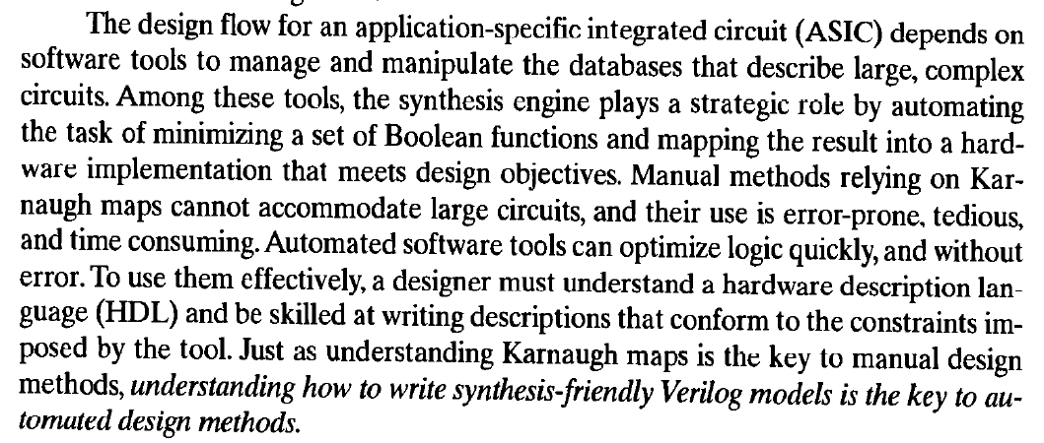
Synthesis of Combinations and Sequential Logic, Chapter 6 Ciletti

Slide 3
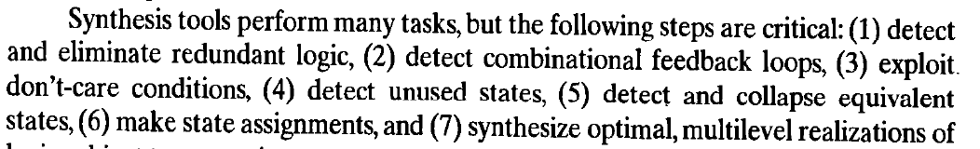
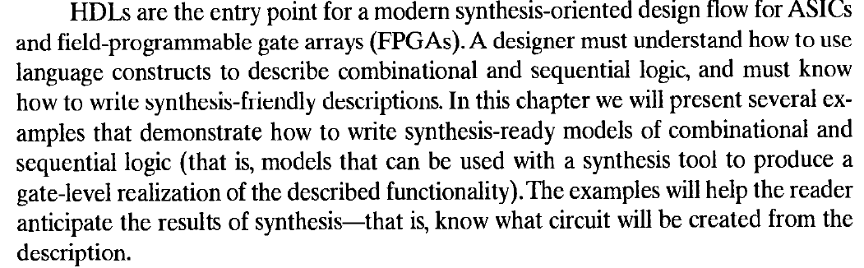

Slide 4
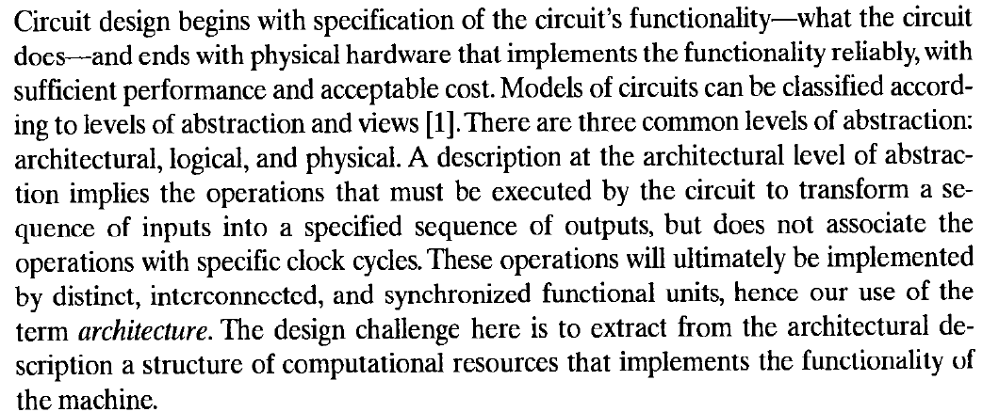
Architecture Level of Design

Slide 5
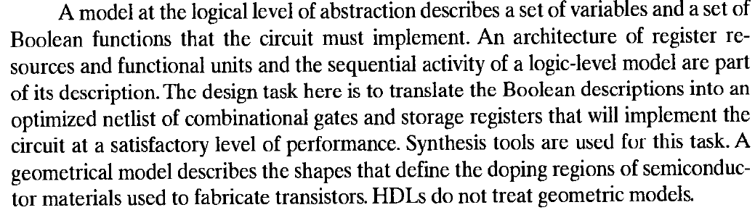
Logical and Geometrical/Physical Level of Design

Slide 6
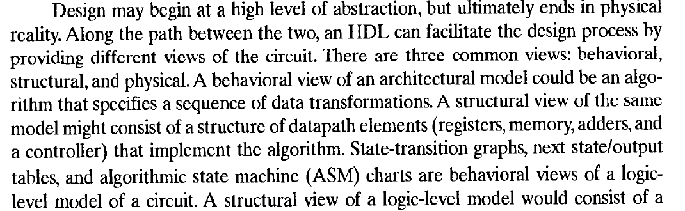
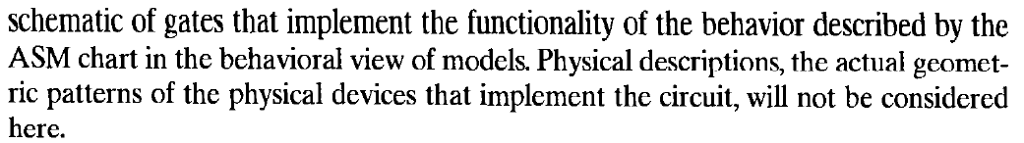

Slide 7
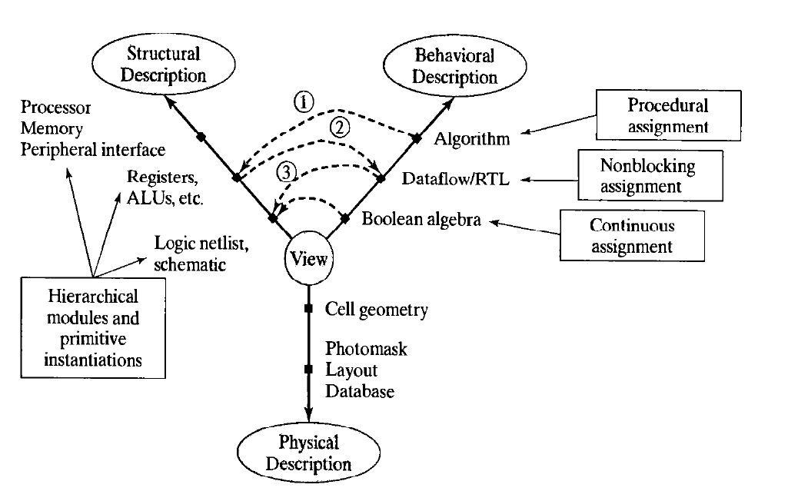
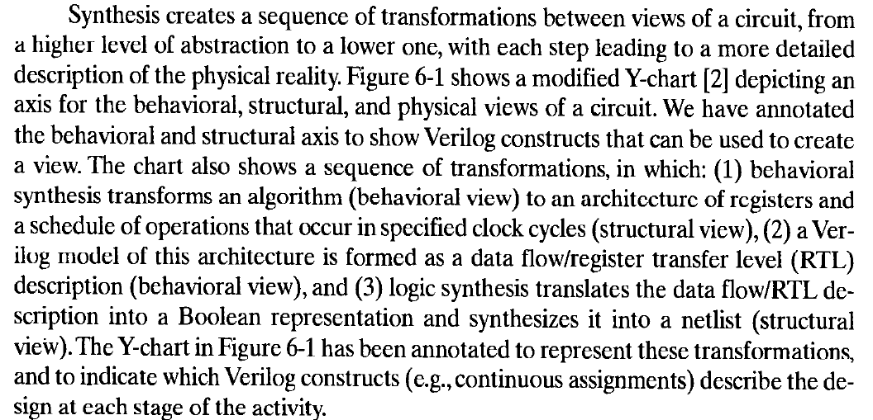

Slide 8
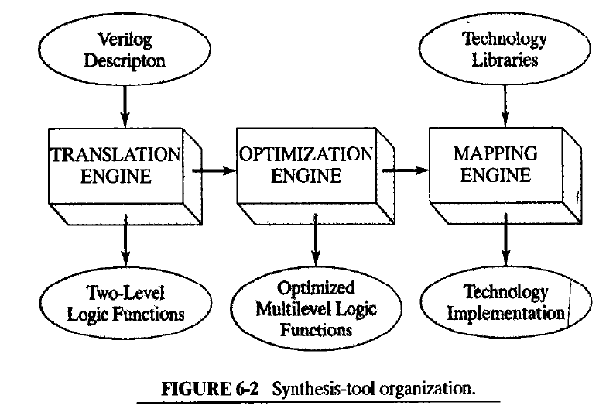
Synthesis Tool Organization

Slide 9
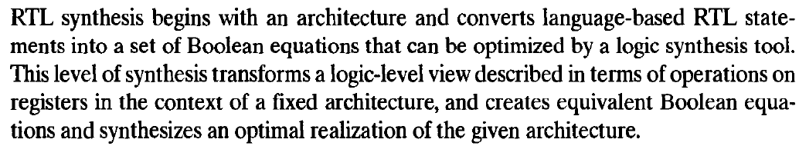
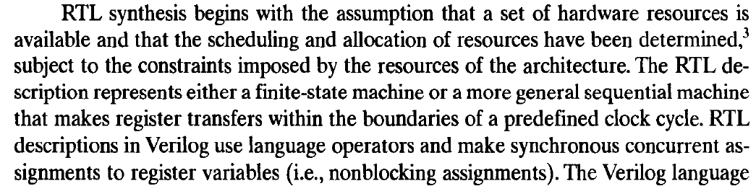
RTL Synthesis

Slide 10
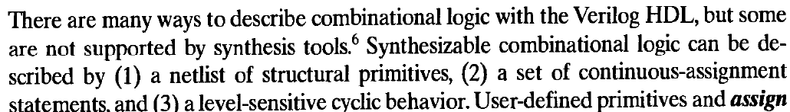
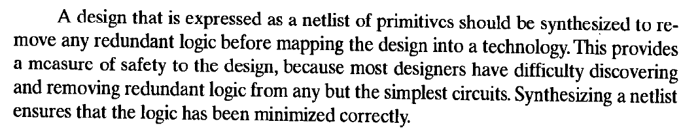
Synthesis of Combinational Logic

Slide 11
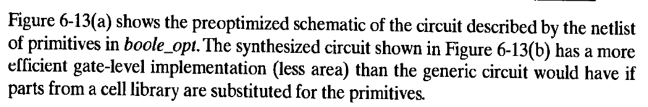
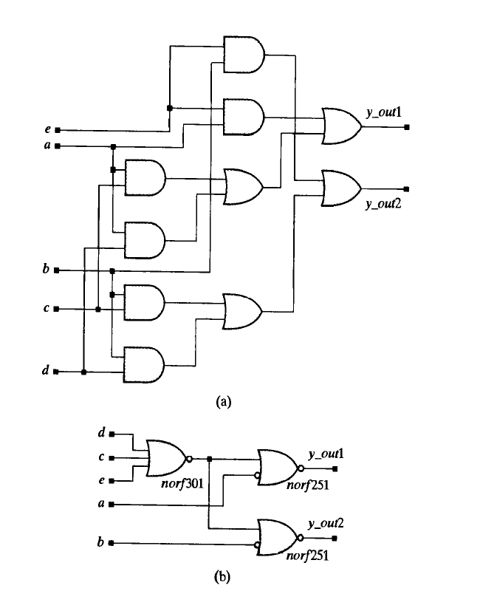
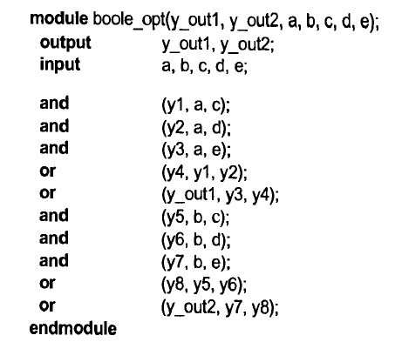
Need to avoid writing at Primitives Level
X

Slide 12
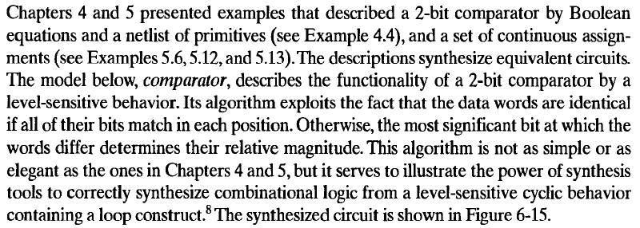
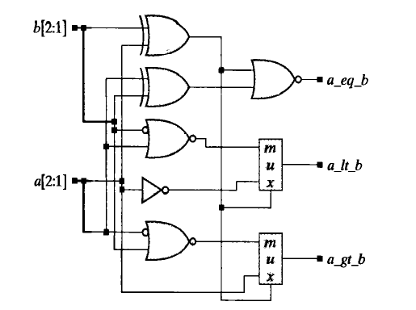
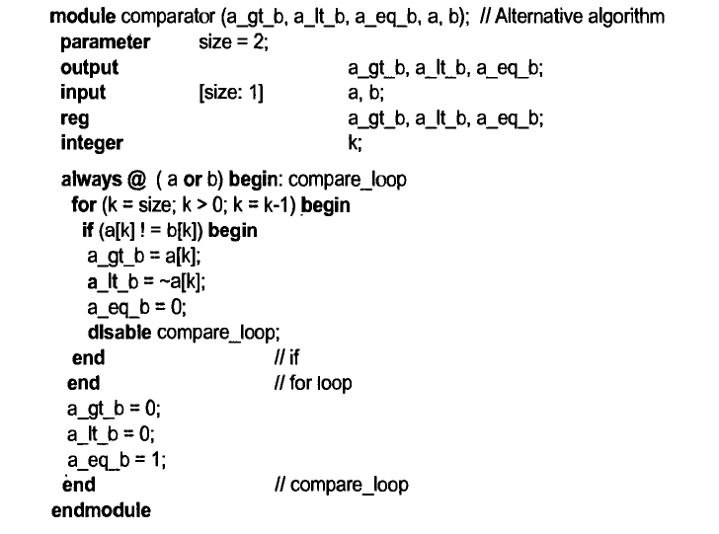

Slide 13
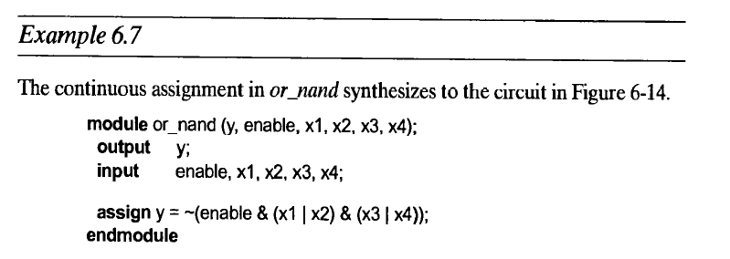
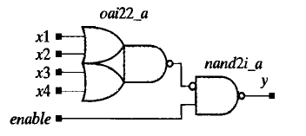

Slide 14
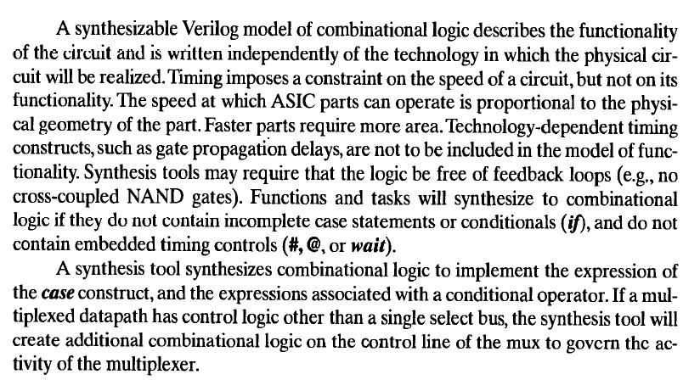
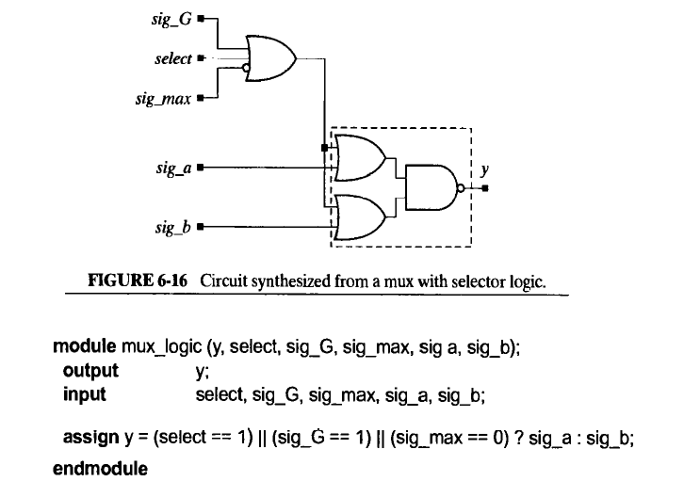

Slide 15
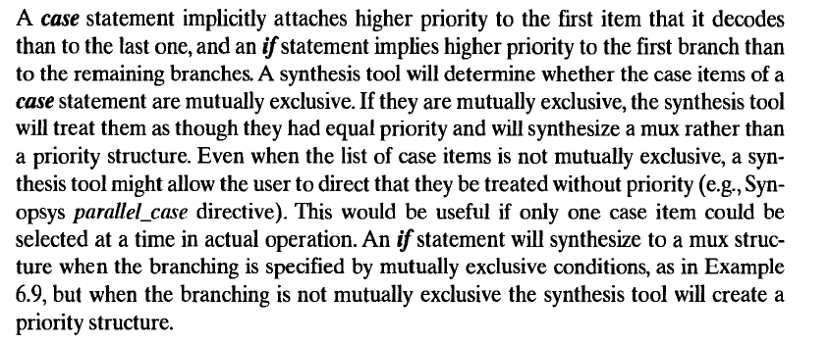
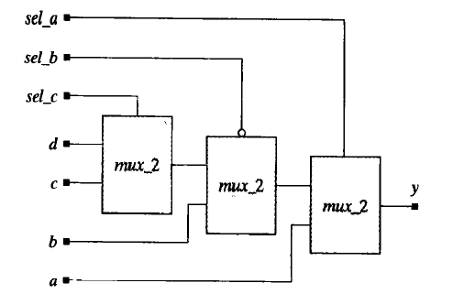
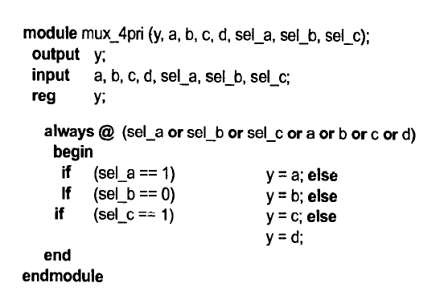
Synthesis of Priority Structures

Slide 16
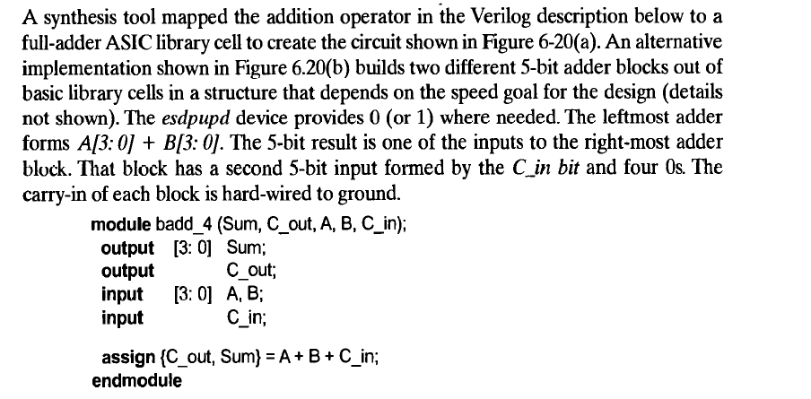
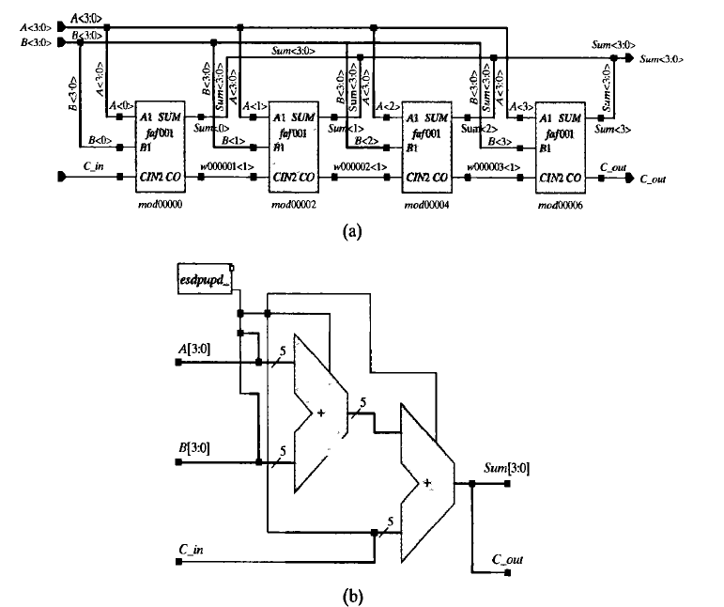

Slide 17
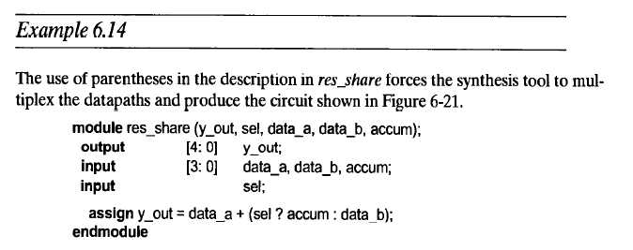
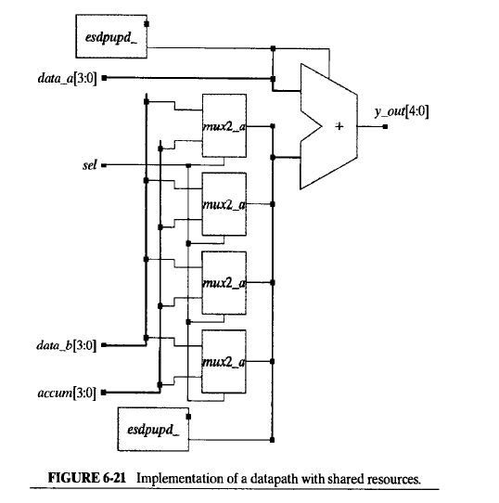
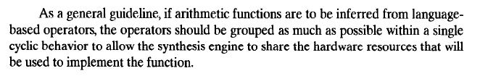

Slide 18
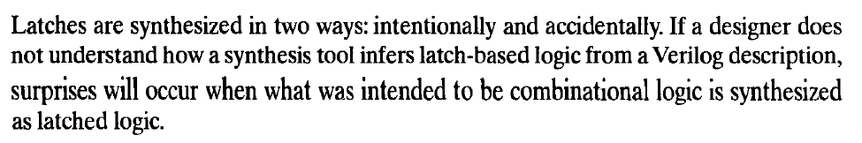
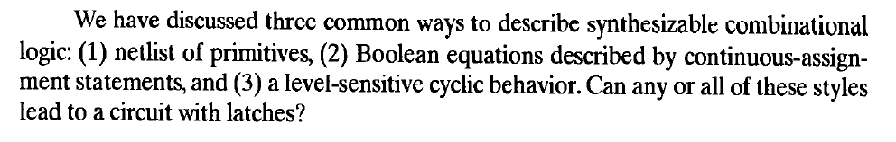
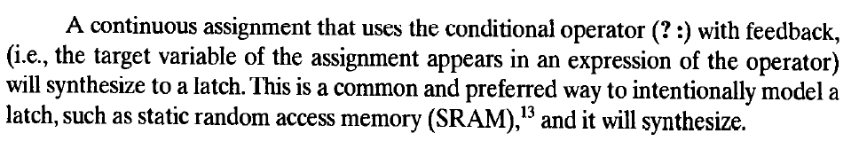
Synthesis of Sequential Logic with Latches

Slide 19
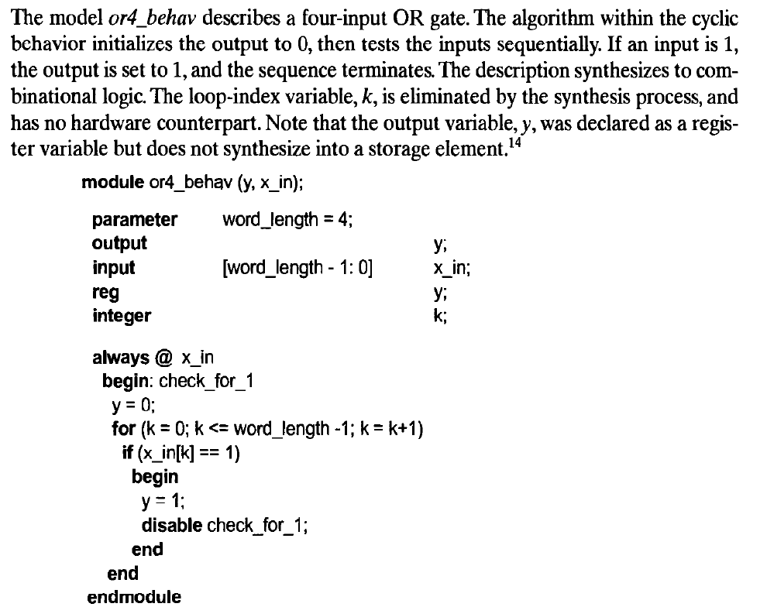
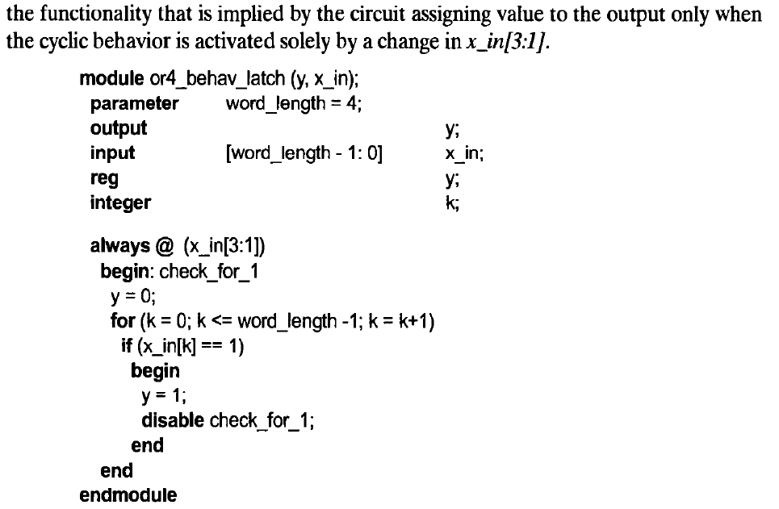
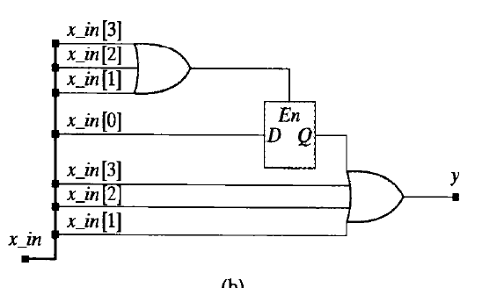
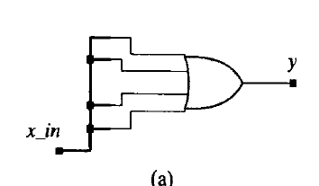
Accidental Synthesis of Latches

Slide 20
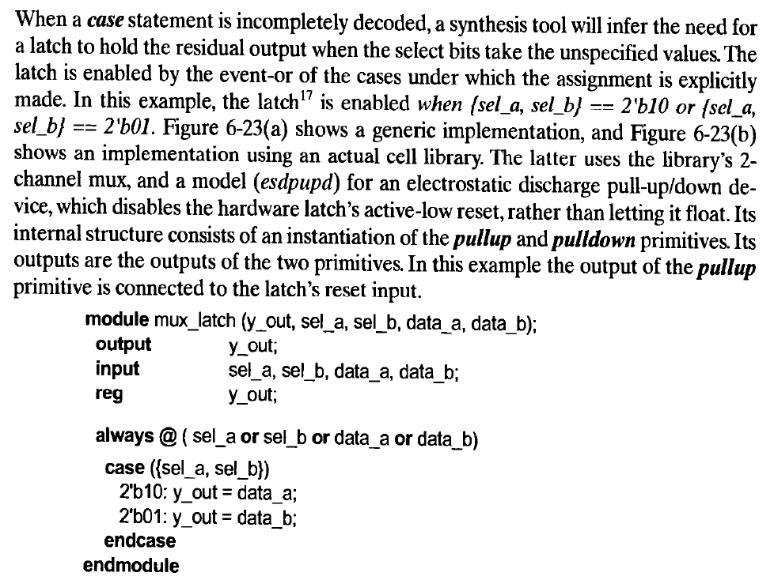
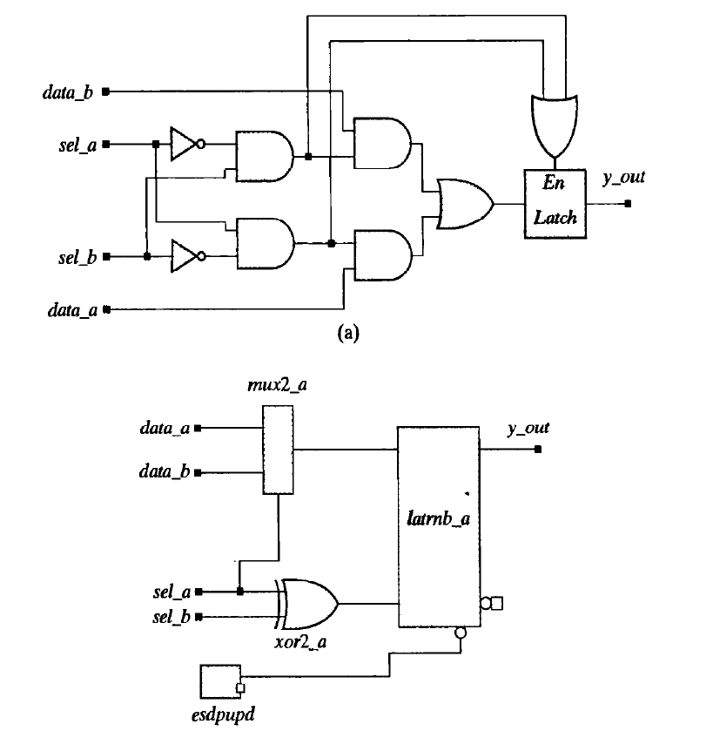
Accidental Synthesis of Latches

Slide 21
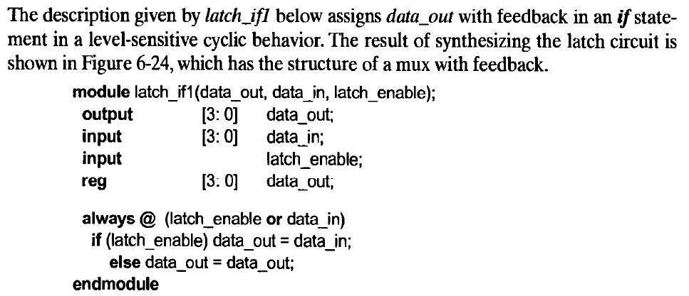
Intentional Synthesis of Latches

Slide 22
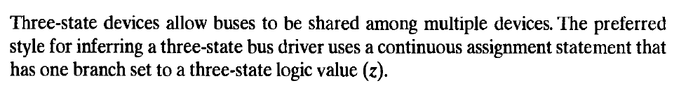
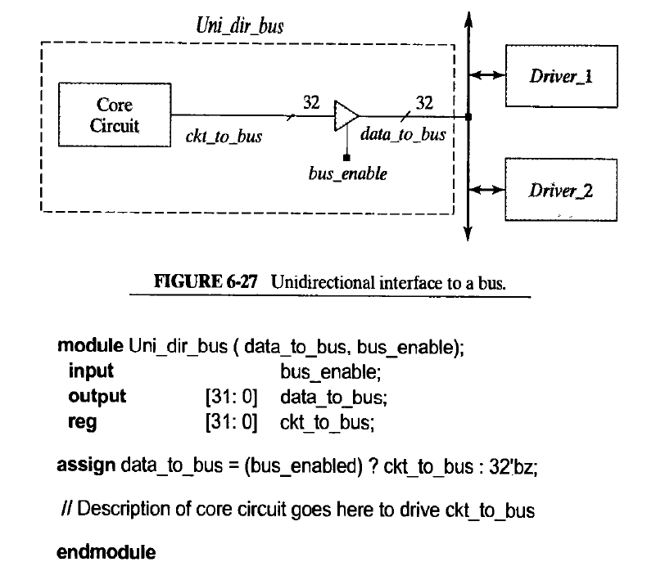
Synthesis of Three-State Devices and Bus Interfaces

Slide 23
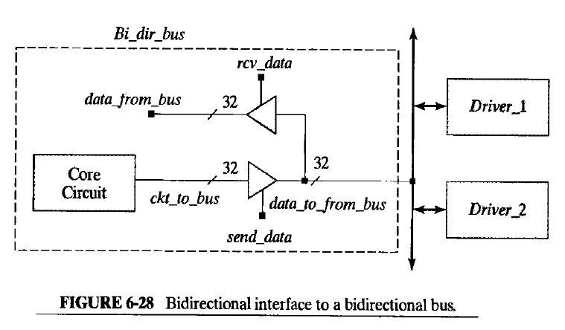
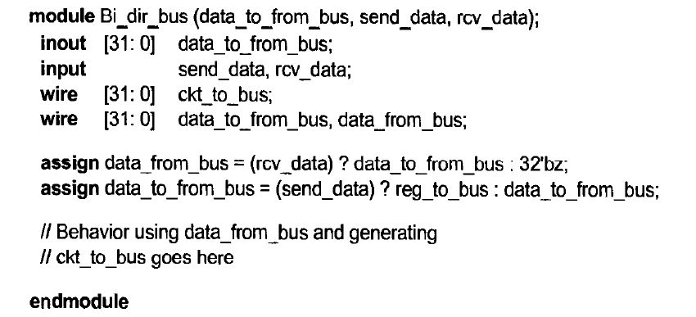
Bidirectional Bus

Slide 24
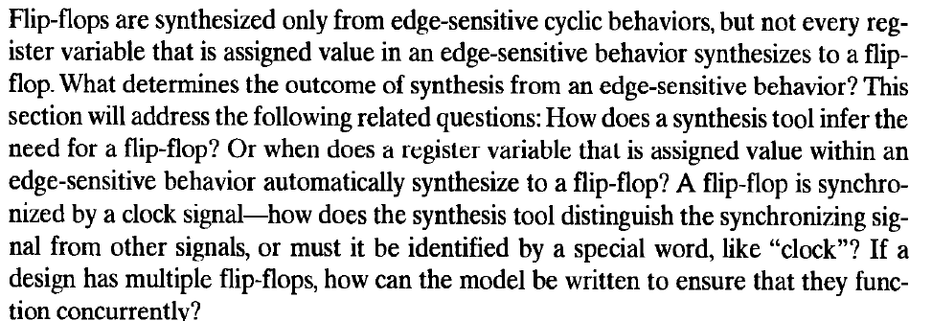
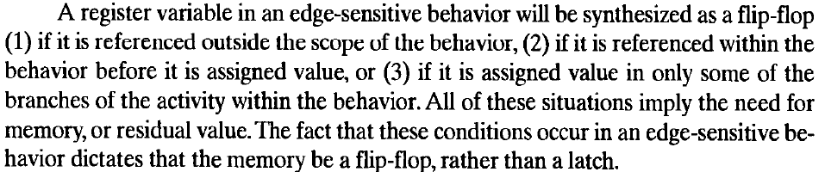
Synthesis of Sequential Logic with Flip-Flops

Slide 25
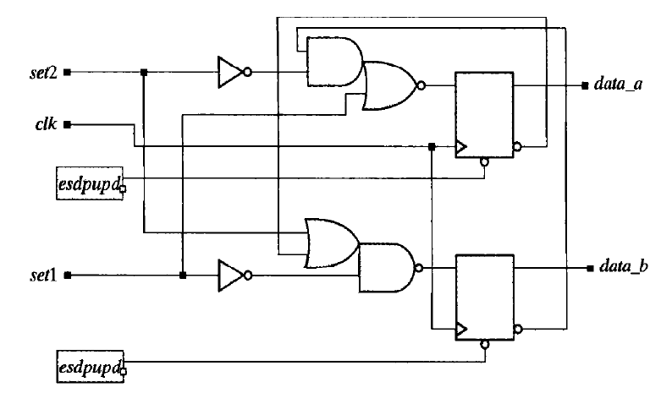
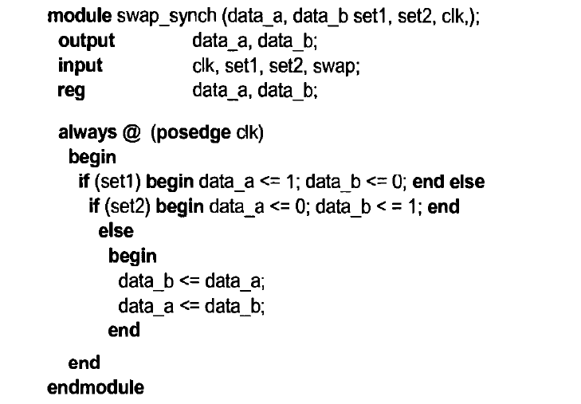

Slide 26



Slide 27


Slide 28



Mealy/Moore Machine

Slide 29


Slide 30


Synthesis of Gated Clocks

Slide 31
Self Study
Counters
Resets
Section 6.12

Slide 32



Design and Synthesis of Data Controllers

Slide 33





Slide 34



Design Example : Binary Counter

Slide 35



Slide 36



Slide 37


Slide 38


Design and Synthesis of a RISC Machine

Slide 39




Slide 40

RISC SPM : PROCESSOR

Slide 41

RISC SPM : ALU

Slide 42



RISC SPM : CONTROLLER PART1

Slide 43



RISC SPM : ISA

Slide 44

RISC SPM : ISA

Slide 45



RISC SPM : CONTROLLER PART2

Slide 46

ASM of Controller
Self-study its remaining part.

Slide 47



Verilog Code of RISC SPM

Slide 48


Verilog Code of RISC SPM

Slide 49

Self-study Controller part.

Slide 50
Assignment 1 – Part2 Coming
Verilog Implementation of the studied RISC Processor.

